Slide 1
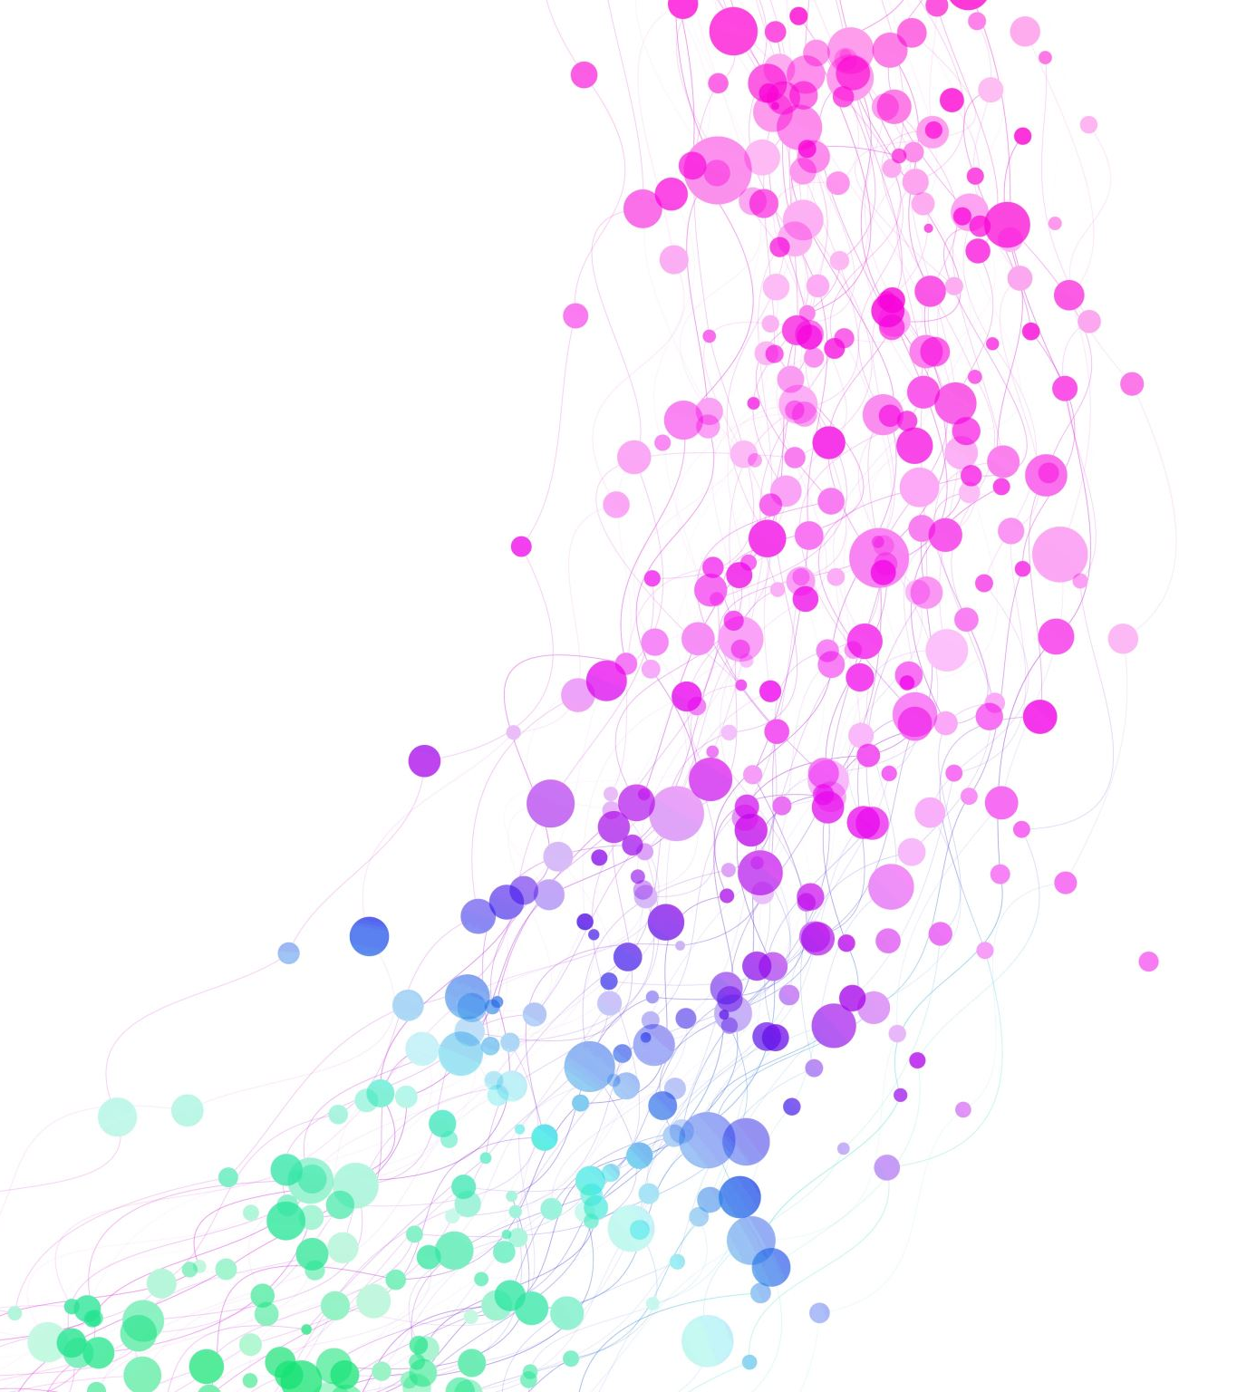
SPRINT 5
BY GOWTHAM RAJ K R

Slide 2
AGENDA
WHAT IS DOCKER?
VIRTUALIZATION VS CONTAINERIZATION
DOCKER ARCHITECTURE
AZURE CONTAINER REGISTRY AND CONTAINER INSTANCES
WHAT IS KUBERNETES AND ITS ARCHITECTURE?
WHAT IS AZURE KUBERNETES SERVICE?
WHAT IS PERSISTENT VOLUME?
WHAT IS AZURE LOAD BALANCER?
WHAT IS AZURE VIRTUAL PEERING?
WHAT IS AZURE FIREWALL?
WHAT IS AZURE APPLICATION GATEWAY?

Slide 3
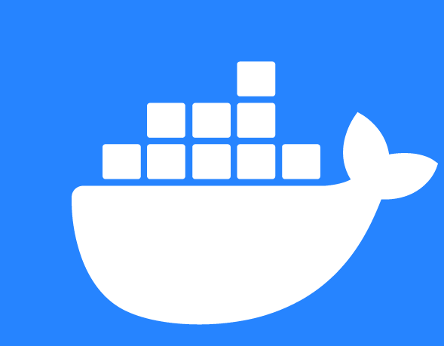
WHAT IS DOCKER?
Key Features of Docker
Flexible resource sharing
Rapid Performance
Lightweight
Isolation
Scalability

Slide 4
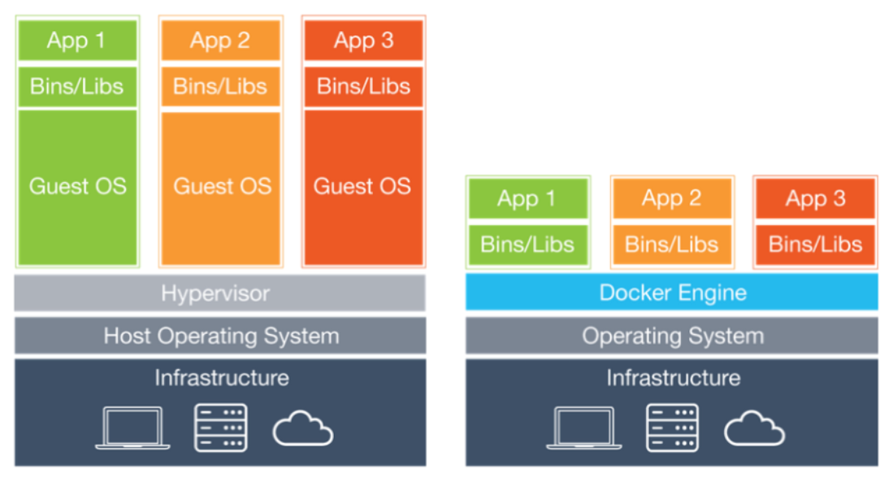
VIRTUALIZATION vs CONTAINERIZATION

Slide 5
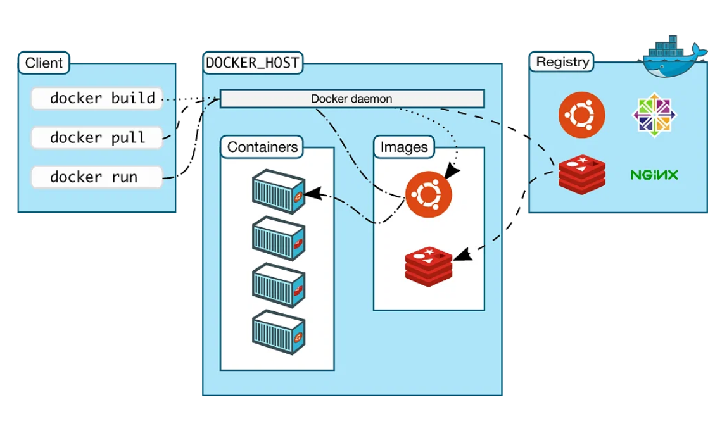
DOCKER ARCHITECTURE

Slide 6
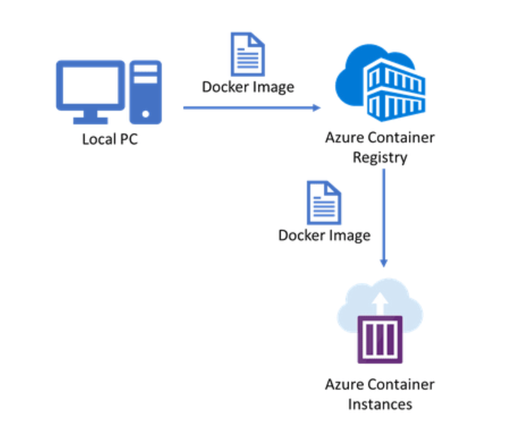
What is Azure Container Registry and Azure Container Instances?
Key Benefits of Azure Container Registry
Ability to find, pull, and push Docker images
Integration with other Azure services
Built-in security features
Role-based access control
Image signing

Slide 7
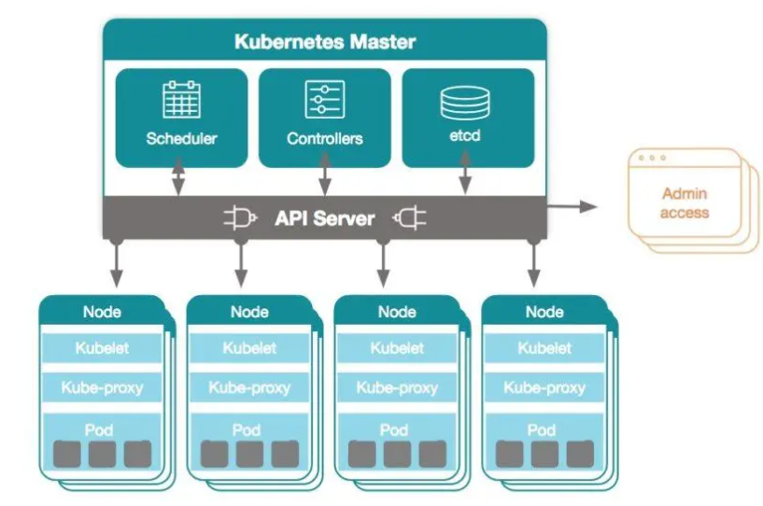
WHAT IS KUBERNETES AND ITS ARCHITECTURE ?

Slide 8
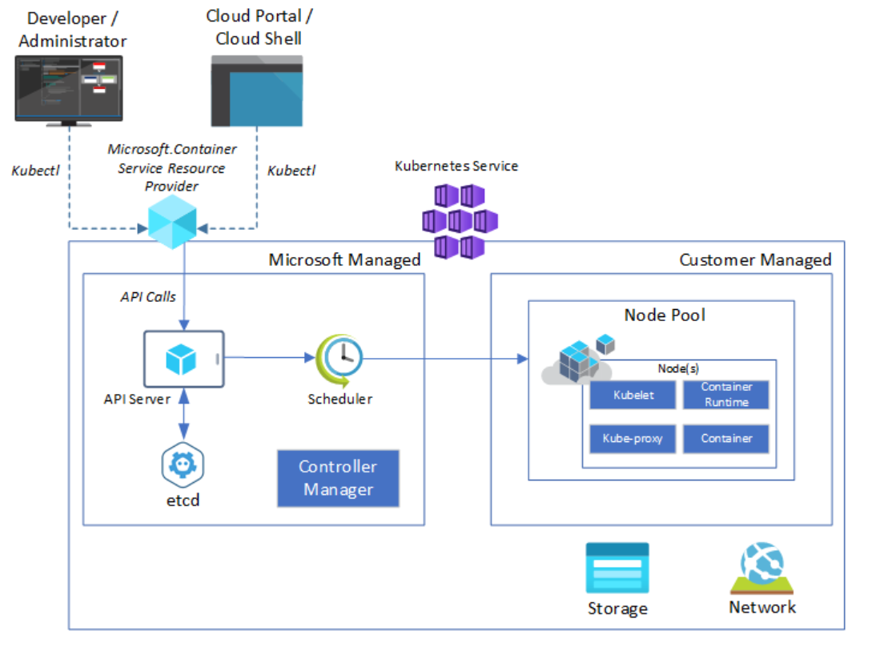
WHAT IS AZURE KUBERNETES SERVICE?
Key Features of AKS
Efficient resource utilization
Faster application development
Security and compliance
Quicker development and integration

Slide 9
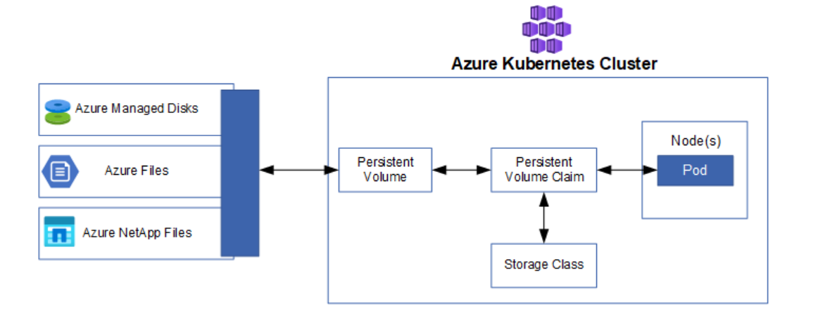
WHAT IS PERSISTENT VOLUME?

Slide 10
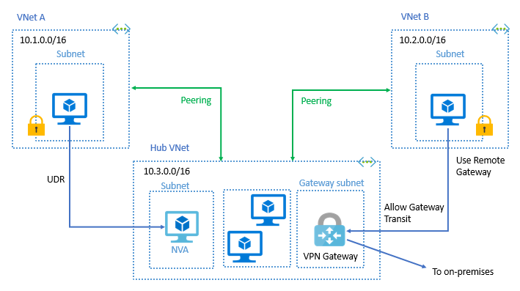
WHAT IS AZURE VIRTUAL NETWORK PEERING?

Slide 11
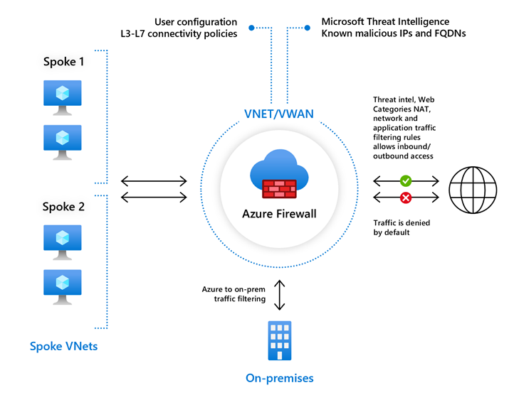
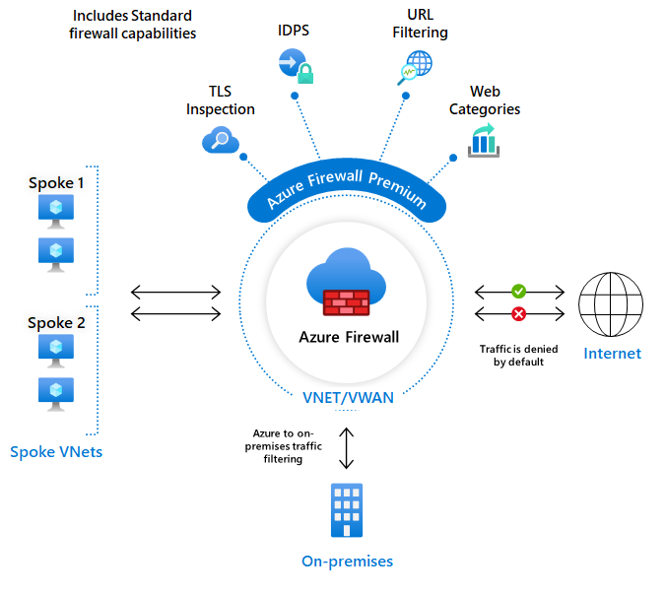
WHAT IS AZURE FIREWALL?

Slide 12
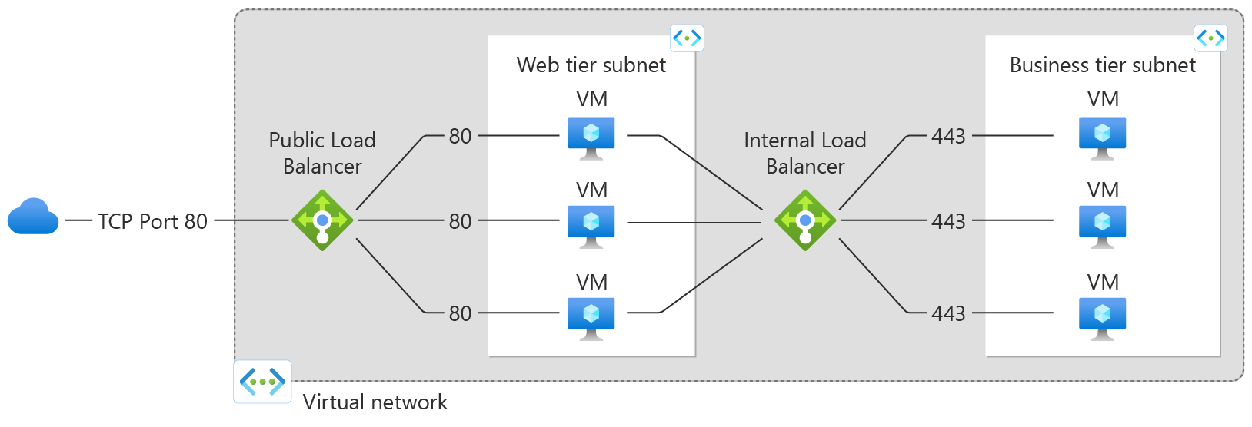
WHAT IS AZURE LOAD BALANCER?

Slide 13
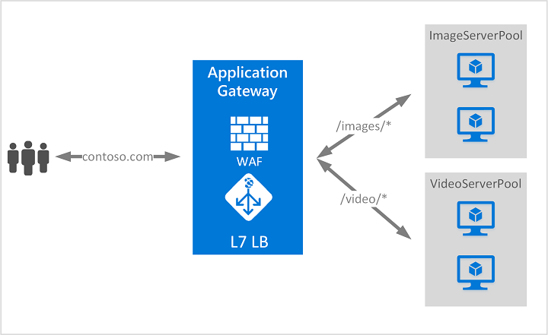
WHAT IS AZURE APPLICATION GATEWAY?
Key Features of Azure Application Gateway
SSL/TLS termination at the gateway.
Autoscaling.
Web Application firewall.
Session affinity.
Zone Redundancy.

Slide 14


